Slide 1
INTRODUCTION ​ TO ​ NETWORKING​
MODULE CODE: CT043-3-1-IN​
TITLE: PRESENTATION​
LECTURER: Er.Yubaraj Sharma​

Slide 2
GROUP MEMBERS:
TEAM MEMEBERS​ | STUDENT NUMBER​ | SIGNATURE​
JITEN CHAPAGAIN​ | NPI000150​ | ​Jiten
​ANKIT ACHARYA | ​NPI000140 | ​Ankit
​PUKAR NEPALI | ​NPI000165 | ​Pukar
​SATINDRA BAHADUR KHADKA | NPI000178​ | ​Satindra

Slide 3
INTRODUCTION
The main purpose of this assignment is to make the network plan for the hardware company known by Seagate.co. The company is in Malaysia and they are planning to create the new network designed for their two building. The names of the two buildings for which we are making the network diagram are Penang and Cyberjaya. Our main purpose is to make the network designed for those two buildings. The pictorial picture i.e., network diagram is done using cisco packet tracer. After that the documentation was done. As we know there are two buildings, we do sub netting and give the network. To make the design we make the diagram using star topology and tree topology. We have used many devices which are essential in the company like computers, laptop, Wi-Fi, router, CCTV, VoIP phone, printer, server etc.

Slide 4
ASSUMPTIONS
In this network diagram we have made many of the assumptions which are essential for the company to run in a smooth way without any hindrance. In this network diagram there are access points with password which help to secure data for being incorrupt. Furthermore, we use Ethernet cable to share network help reduce chance of data incorruption. In the switch box we open all the ports and make them accessible so that we can easily connect the other device and switches as per our requirement and need. In telephone service the max number of phones we can use is only 10 because another person cannot connect and listen to the communication.

Slide 5
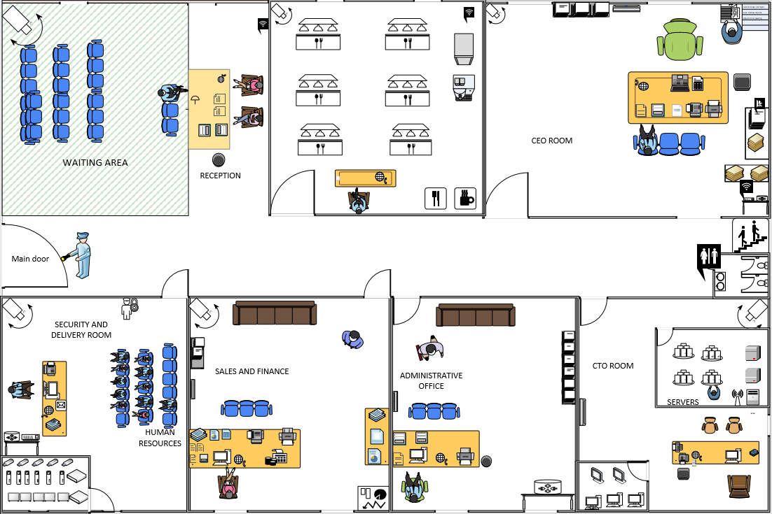
PENANG BUILDING FLOOR-1 (JITEN)

Slide 6
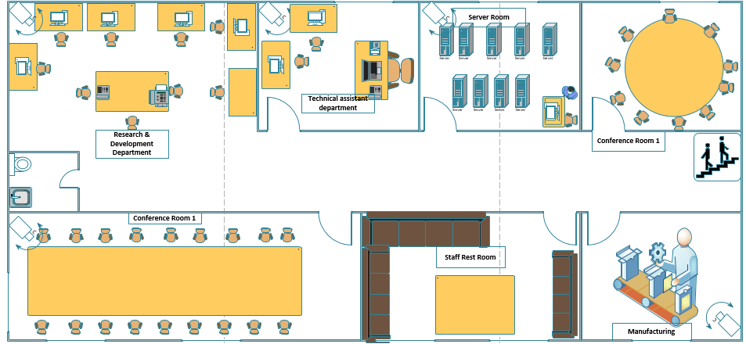
PENANG BUILDING FLOOR-1 (SATINDRA)

Slide 7
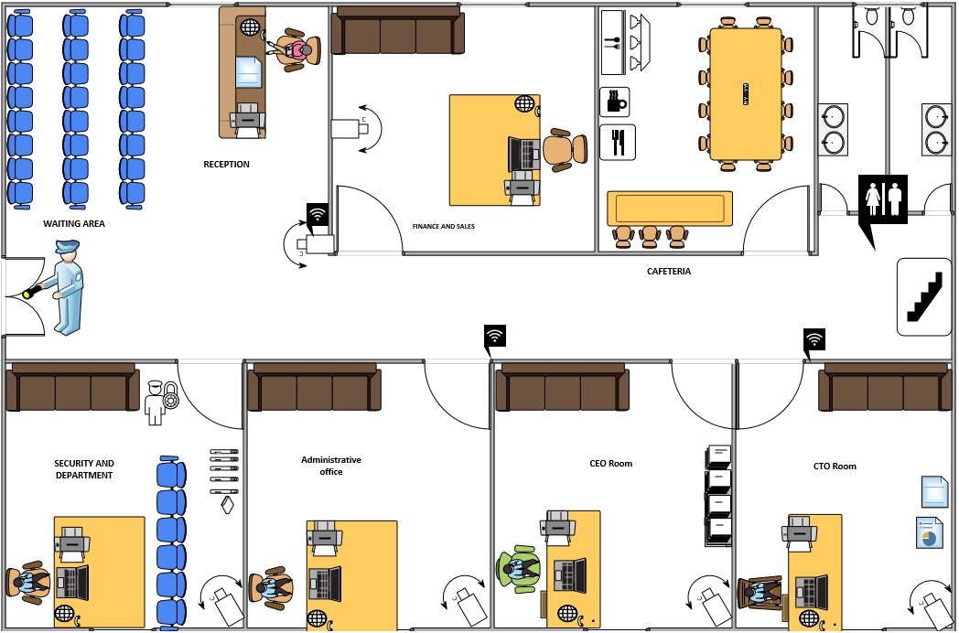
Cyber Jaya BUILDING FLOOR-1 (PUKAR)

Slide 8
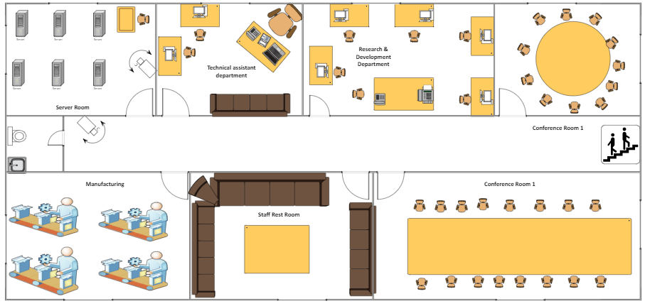
Cyberjaya BUILDING FLOOR-2 (ANKIT)

Slide 9
HOST AND NETWORKING DEVICES​
DESKTOP PC ​
ROUTER
SWITCH
LAPTOP
SMARTPHONE
VOIP PHONE
PRINTERS
CCTV CAMERA
WIRELESS ROUTER

Slide 10
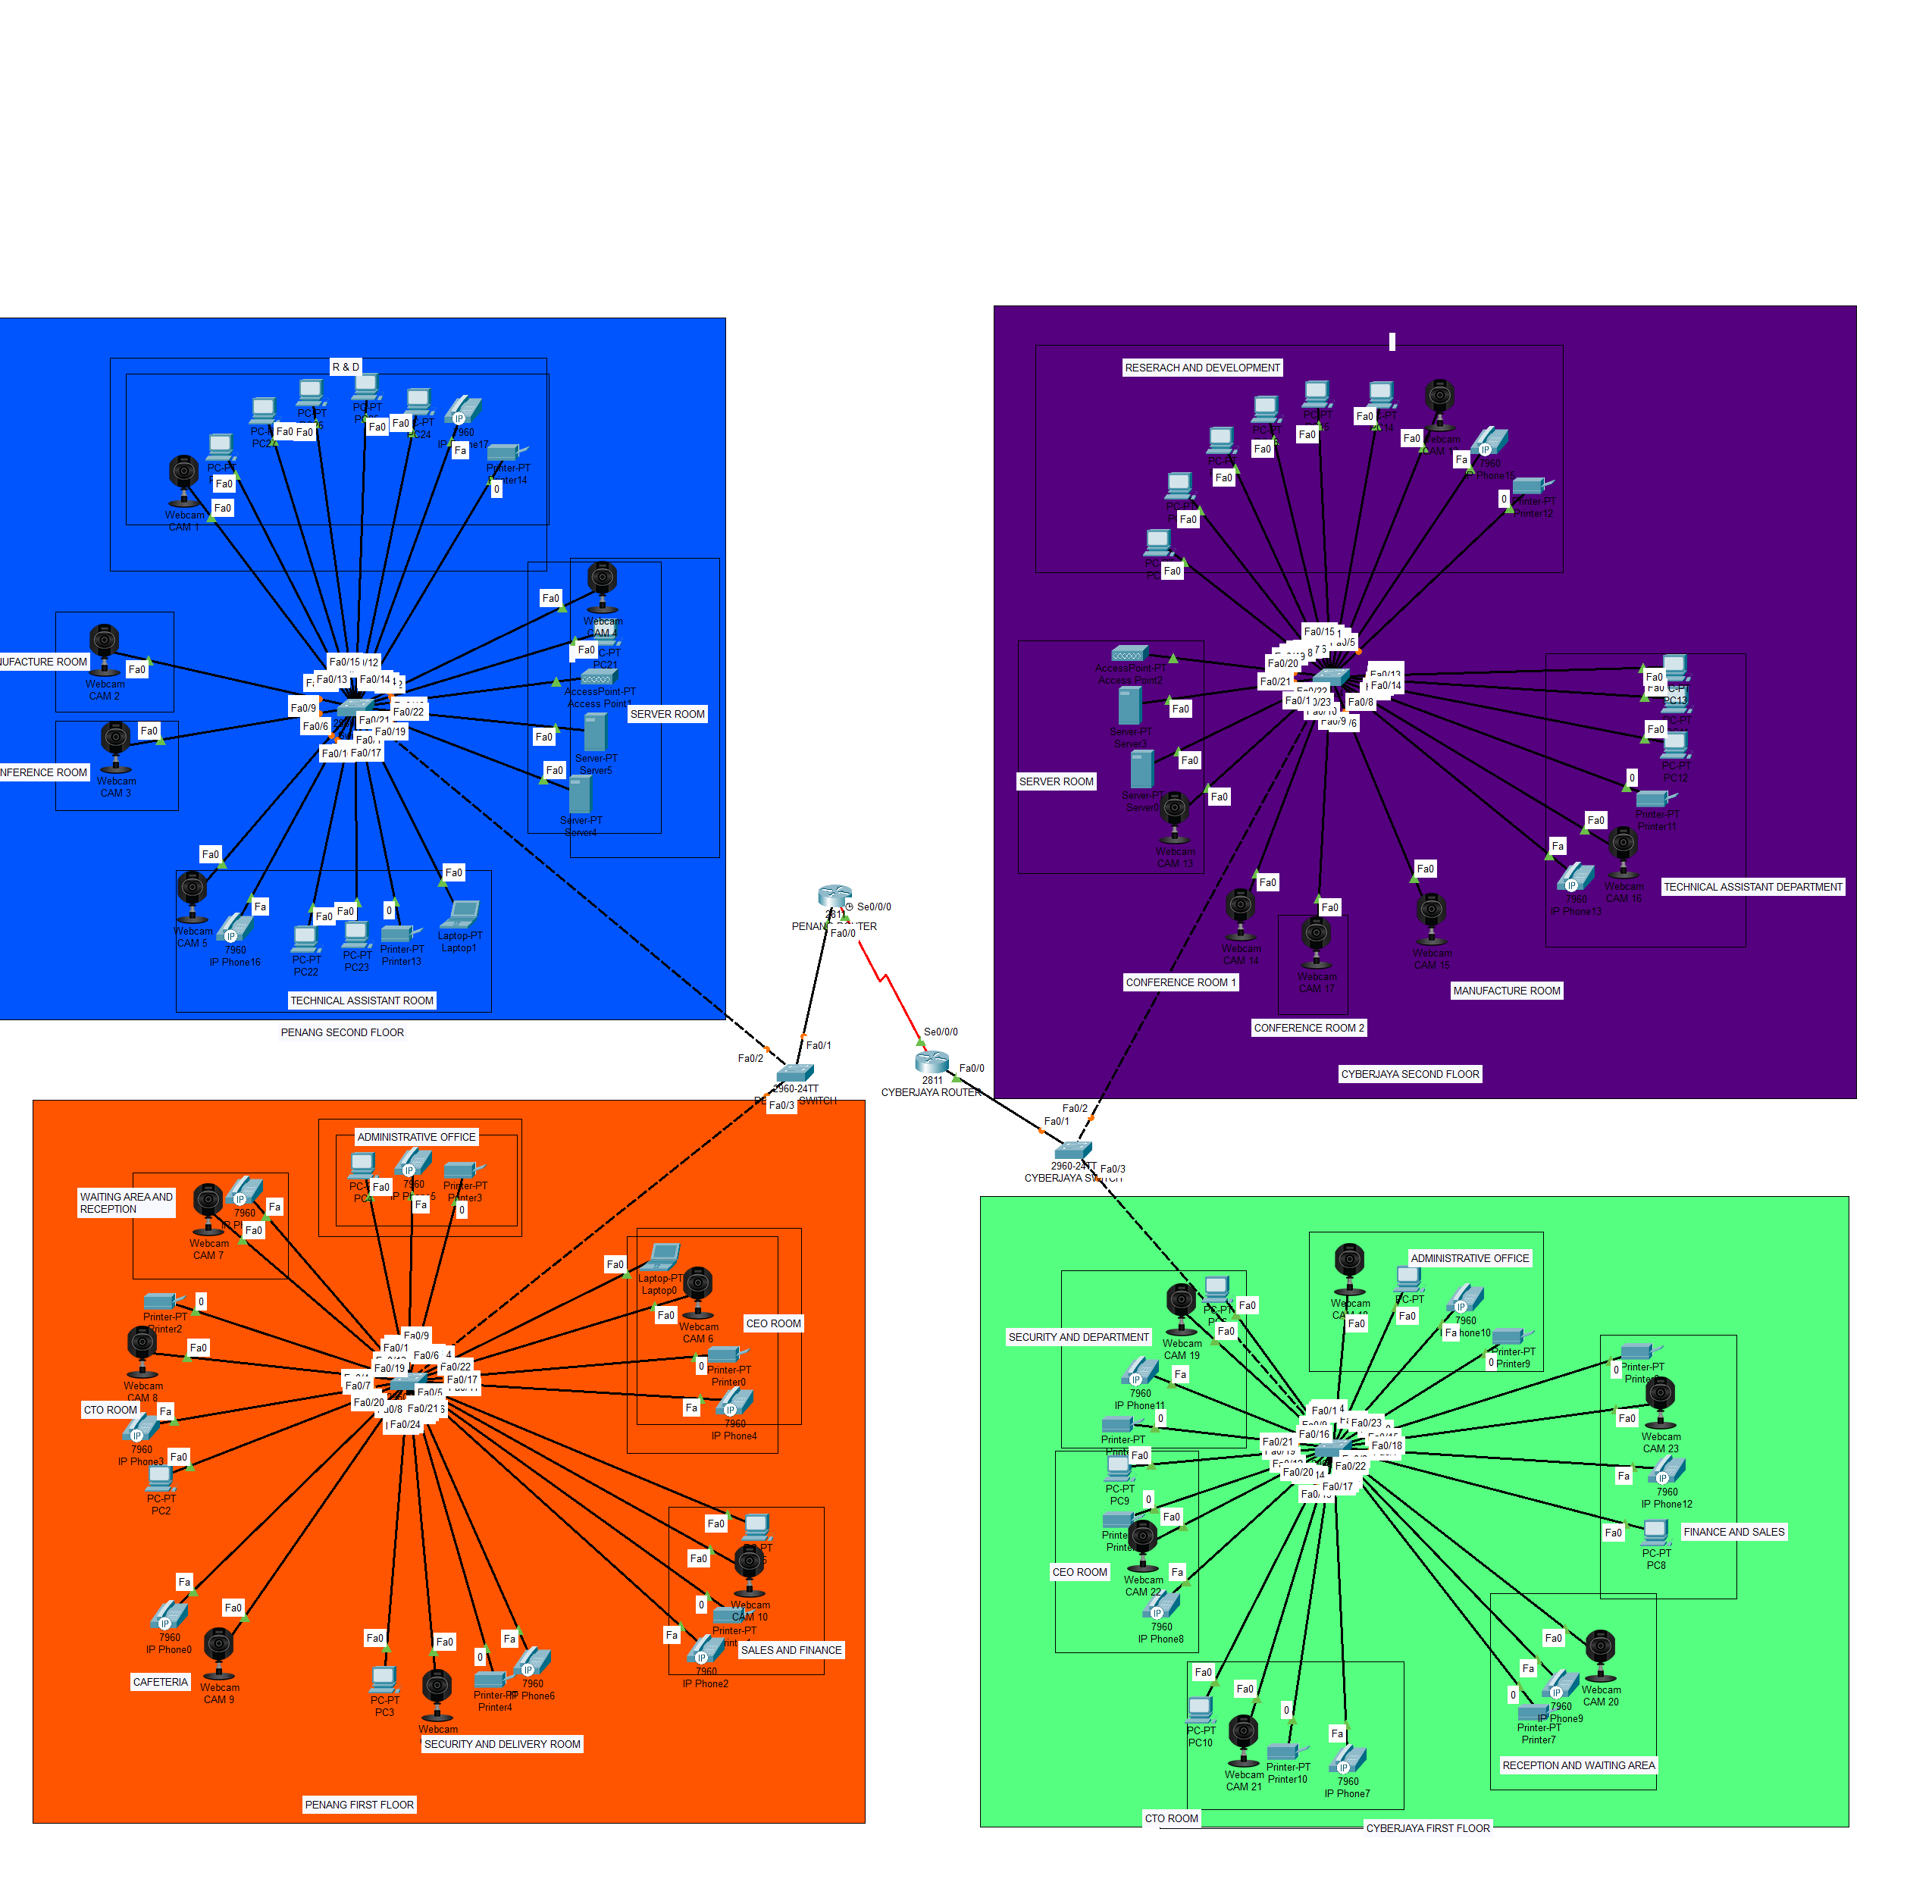

Slide 11
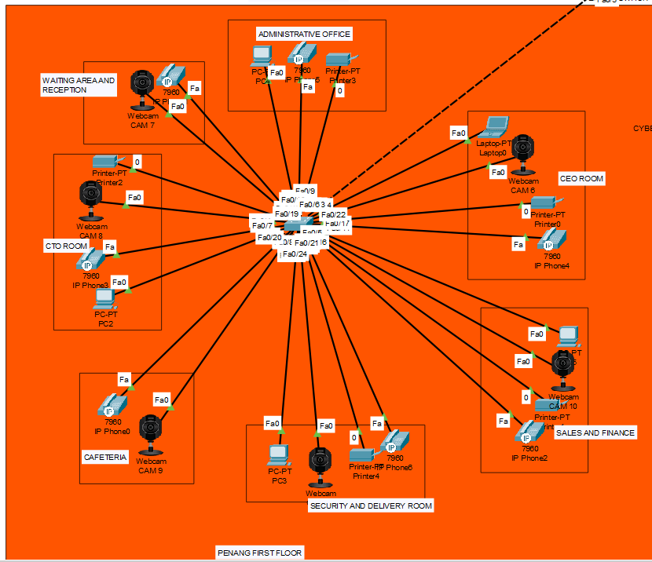
TOPOLOGIES

Slide 12
In this project we have used the popular topology use in networking i.e., star topology in both building Penang and Cyberjaya. In this topology, network is divided into multiple layer. In LAN, network device have three prime categories. In the bottom, layer computer is connected know as access layer. In middle layer, there are two layer where server are connected. From this topology, the new device which is use in company can be easily be connected and disconnected. Increasing speed of the internet is also easily done in this topology. It has some many advantage. So, in this project we have use this topology. Whereas, if there is network issue we can simply find the problem and overcome it. Maintenance- of the network will be easy.

Slide 13
CONCLUSION
This project was completed with the hard work and research of the whole team. The network design with network diagrams as well as network configuration was successfully done with the help of Cisco Packet Tracer. The floor design was done with the help of Microsoft Visio software. Overall, the requirement of Seagate Co. was successfully fulfilled.

Slide 14
CONTINUE TO
CISCO PACKET TRACER…….

Slide 15
ANY QUESTIONS……….

